Slide 1
Guide to Networking Essentials,
6th Edition
Chapter 8: Network Operating System Fundamentals

Slide 2
Objectives
Describe the major components of an OS, including file system, processes, and the kernel
Discuss network operating systems and compare client and server OSs
Describe the components of virtualization and virtualization products
Plan for an OS installation and perform post-installation tasks
Copyright © 2012 Cengage Learning. All rights reserved.

Slide 3
Operating System Fundamentals
An operating system (OS) provides a convenient interface for users and applications to access the computer’s hardware components
The next few slides will expand on the following OS concepts:
  File systems
  Processes and services
  Kernel
Copyright © 2012 Cengage Learning. All rights reserved.

Slide 4
Operating System Fundamentals
A file system is the method by which an OS stores, organizes, and manages access to files on a storage device (such as a hard drive)
File systems have the following objectives:
  Provide a convenient interface for users and applications to open and save files
  Provide an efficient method to organize space on a drive
  Provide a hierarchical filing method to store files
  Provide an indexing system for fast retrieval of files
  Provide secure access to files for authorized users
Copyright © 2012 Cengage Learning. All rights reserved.

Slide 5
Disk Drive Space Organization
Storage space on a disk drive is divided into sectors, and one or more sectors are grouped to make a cluster or block
  Cluster is the smallest amount of space that can be occupied by a file
A disk’s cluster size is selected when the disk is formatted
  If you know that you’re going to store many files under 2048 (2K) bytes, choose a smaller cluster size when you format
The formatting process groups sectors into clusters and maps all disk clusters for fast access
Copyright © 2012 Cengage Learning. All rights reserved.

Slide 6
Hierarchical Filing Method
Most file systems organize files in a hierarchy of folders or directories
Top of the hierarchy is called the “root”
  The root often represents a disk drive or other mass storage drive
Off the root of the file system can be files and folders, with folders containing files and additional folders (called subfolders)
Copyright © 2012 Cengage Learning. All rights reserved.

Slide 7
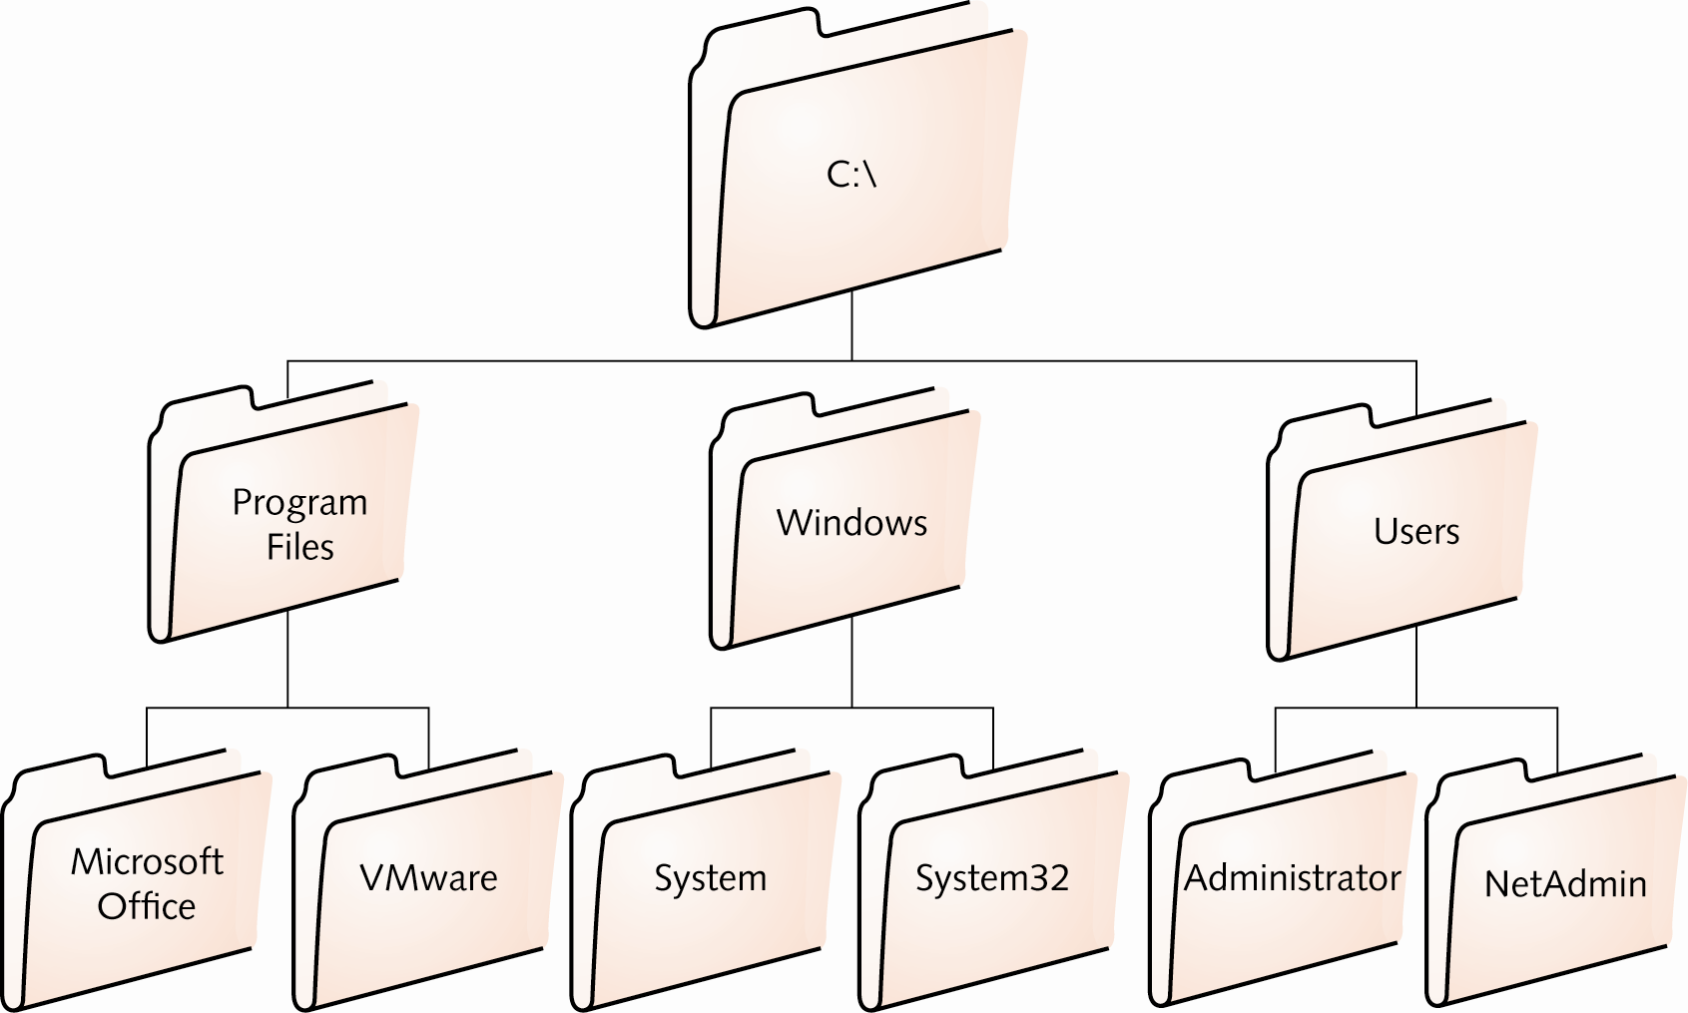
Hierarchical Filing Method
A Hierarchical Filing System
Copyright © 2012 Cengage Learning. All rights reserved.

Slide 8
File Indexing System
With large disks, more files can be stored so it may be sometimes difficult to find files that might be needed
Most file systems include an indexing system that enables users to search for a file based on all or part of a filename
The indexing system maintains a database that’s updated as files are created
Copyright © 2012 Cengage Learning. All rights reserved.

Slide 9
Secure Access to Files
Computers are often shared today
  Each user may want files or documents that other users can’t access
A file system’s access controls (permissions) can be used to allow only authorized users to access certain files or folders
Access controls can be used to secure OS files from accidental corruption or deletion
Most current OSs include access controls
  Older DOS and Windows FAT16 and FAT 32 don’t support file and folder permissions
Copyright © 2012 Cengage Learning. All rights reserved.

Slide 10
Operating System Fundamentals
A process is a program that is loaded into memory and run by the CPU
  Can be an application or a program that communicates with and provides services to other processes (called a “service” in Windows and a “daemon” in Linux)
Network services allow your computer and applications to perform tasks they otherwise couldn’t
  Example: When using a Web browser to access a Web server, most people use a name rather than its address. A name lookup is required before a Web browser can do its main job. Domain Name Service (DNS) runs as a process to provide the name lookup service
In Windows 7, you can use a tool called a Task Manager to see all processes and services running
Copyright © 2012 Cengage Learning. All rights reserved.

Slide 11
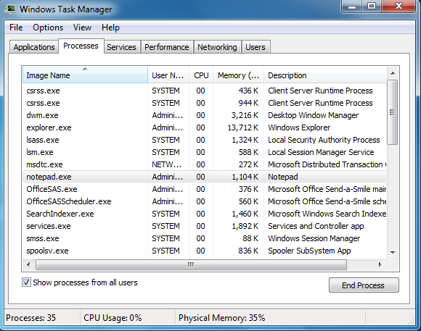
Operating System Fundamentals
Windows Task Manager
Copyright © 2012 Cengage Learning. All rights reserved.

Slide 12
Operating System Fundamentals
An OS can run many processes at the same time by using multitasking
A computer multitasks by using a method called time slicing - occurs when a CPU’s computing cycles are divided between more than one process
  The act of changing to another process is called context switching
Two types of multitasking:
  Preemptive: OS controls which process gets access to the CPU and for how long
  Cooperative: OS can’t stop a process; a process maintains control until it satisfies its computing needs
Copyright © 2012 Cengage Learning. All rights reserved.

Slide 13
Operating System Fundamentals
Many applications are now designed so that different parts can be scheduled to run separately
Each part that can be scheduled to run is called a thread
A multithreaded application has two or more threads that can be scheduled separately for execution by the CPU
Multiprocessing allows performance of multiple tasks or threads simultaneously, each by a different CPU or CPU core
Copyright © 2012 Cengage Learning. All rights reserved.

Slide 14
Network Operating System Overview
Desktop OSs now include many features that were once only found on a server OS.
A desktop OS is now classified as an NOS (network operating system)
The determining factor of whether you need a server NOS or a client NOS is what role the computer will play in your network
Most desktop computers have the following network client software:
  DHCP client - DNS client
  HTTP client - File-sharing client
  Email client
Copyright © 2012 Cengage Learning. All rights reserved.

Slide 15
DHCP Client
A computer can be assigned an IP address statically or dynamically with DHCP
When an OS is first installed, IP address assignment is done through DHCP by default
When a computer requests its IP address, the following broadcast packets are involved:
  DHCPDiscover: client announces to the network that it is looking for a DHCP server
  DHCPOffer: The server replies and offers an IP address
  DHCPRequest: The client wants the offered IP address
  DHCPPAck: The server acknowledges the transaction and the client can now use the IP address
Copyright © 2012 Cengage Learning. All rights reserved.

Slide 16
DHCP Client
When half the lease is over, the client sends a unicast DHCP request packet to the server
  The server sends a unicast DHCPAck to indicate the address was renewed
Most administrators manage IP configurations using DHCP but still manually assign IP addresses to network printers, servers and some workstations (those that need IP addresses that don’t change)
Copyright © 2012 Cengage Learning. All rights reserved.

Slide 17
DNS Client
The DNS client is responsible for communicating with a DNS server to resolve computer and domain names to IP addresses
Referred to as a “resolver”
An OS must be configured to use DNS and needs at least one address of a DNS server that it can query
In Windows, the first DNS server configured is called the preferred DNS server and the second one is the alternate DNS server
Copyright © 2012 Cengage Learning. All rights reserved.

Slide 18
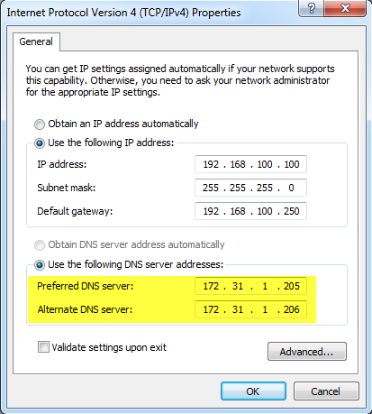
DNS Client
Preferred and alternate DNS servers in Windows
Copyright © 2012 Cengage Learning. All rights reserved.

Slide 19
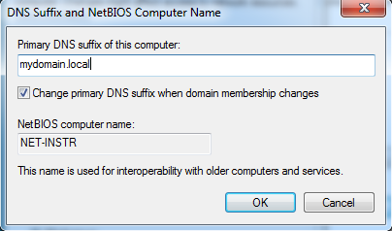
DNS Client
DNS servers require a domain name in addition to a computer name
In Windows, the default domain appended to DNS lookups is called the primary DNS suffix
In this figure: If a user attempts to contact server1, the DNS resolver sends the
query to the DNS
server as server1.mydomain.local
Copyright © 2012 Cengage Learning. All rights reserved.

Slide 20
HTTP Client
HTTP client software is built into programs that use it, such as Web browsers
HTTP can be used to transfer large files and has the ability to create secure connections by using HTTPS
  The “S” designates the use of Secure Sockets Layer, a protocol that encrypts data before it’s transferred and decrypts it on receipt
For normal, unencrypted connections, HTTP uses TCP port 80 by default (HTTPS uses port 443)
Copyright © 2012 Cengage Learning. All rights reserved.

Slide 21
File-Sharing Client
A file-sharing client allows the computer to access files and printers on the network
When a user requests a resource, a redirector intercepts the request and examines it to determine whether the resource is local (on the computer) or remote (on the network)
With redirectors, network resources can be accessed as though they were local
With drive mapping, shared network folders are accessed just like a drive that is physically attached to the system
Copyright © 2012 Cengage Learning. All rights reserved.

Slide 22
File-Sharing Client
In Windows, the two most common ways to access a shared resource are using the UNC path or mapping a drive
UNC example:
  \\server-name\sharename\subfolder\file.extension
  You can use the UNC path to access shared folders/printers but you must type the path every time or create a shortcut to it
Using the net command example:
  Net use drive-letter:\\server-name\sharename
  The drive-letter is an unused driver letter and must be followed by a colon (:)
  The command can be entered at a command prompt, logon script or batch file
Copyright © 2012 Cengage Learning. All rights reserved.

Slide 23
File-Sharing Client
The protocol used in Windows to share files and printers is SMB, also known as Common Internet File System (CIFS)
Linux also supports SMB implemented as an installation option called Samba
The native file-sharing protocol in the Linux environment is Network File System (NFS)
Copyright © 2012 Cengage Learning. All rights reserved.

Slide 24
E-mail Client
E-mail is based on its own set of protocols
Most common e-mail protocols:
  Post Office Protocol version 3 (POP3): used to download or retrieve incoming messages from an e-mail server to their local desktops
  Simple Mail Transport Protocol (SMTP): standard protocol for sending Internet and other TCP/IP-based email
  Internet Message Access Protocol (IMAP): has advanced message controls, including the capability to manage messages locally yet store them on a server
Copyright © 2012 Cengage Learning. All rights reserved.

Slide 25
E-mail Client
After a user sends a message, the email client software contacts an SMTP server
The SMTP server receives the message, looks up the domain name of the destination address, and contacts an SMTP server at the destination’s domain
The destination SMTP server sends the message to the POP3 server containing the recipient’s mailbox
The POP3 server deposits the message in the recipient’s mailbox until the mailbox owner instructs the e-mail client software to retrieve messages
If you’re using IMAP instead of POP3, only message headers are sent (usually sender and subject)
Simulation 18 – How e-mail works
Copyright © 2012 Cengage Learning. All rights reserved.

Slide 26
The Role of a Server Operating System
Memory, CPU, and disk usage on client OSs are optimized to run user applications and client network software
Server OSs are optimized to run network services in the background to speed up responses to client
Most server OSs in a typical network provide:
  Centralized user account and computer management
  Centralized storage
  Infrastructure services, such as name resolution and address assignment
  Server and network fault tolerance
Copyright © 2012 Cengage Learning. All rights reserved.

Slide 27
User Authentication and Authorization
Authentication is the process of identifying who has access to the network
  Most common form is a logon with a username and password
  Other forms include digital certificates, smart cards, and biometric scanners
Authorization is the process of granting or denying an authenticated user’s access to network resources
Copyright © 2012 Cengage Learning. All rights reserved.

Slide 28
Account Management
Most OSs now incorporate account management for the purposes of authentication and authorization
The server version of Windows OSs includes a centralized account management, authentication, and authorization system called Active Directory
When Active Directory is installed on a server, the server becomes a domain controller, and users and computers with accounts are referred to as domain members
Copyright © 2012 Cengage Learning. All rights reserved.

Slide 29
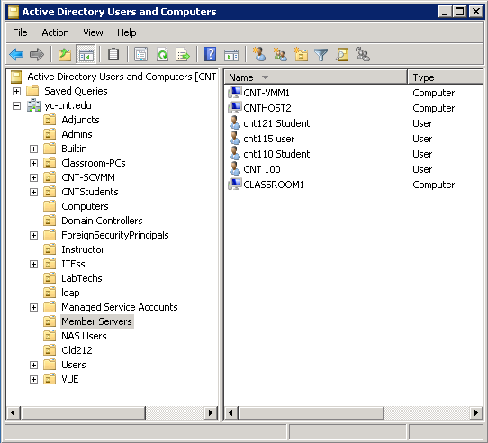
Account Management
Active Directory Users and Computers Management Console
Copyright © 2012 Cengage Learning. All rights reserved.

Slide 30
Security Policy Management
Accounts in Active Directory are used to distribute and enforce policies for network use and security
  These policies are called group policies
Policies can control what icons appear on a user’s desktop or can control password restrictions and what applications a user can run on a computer (among other things)
Linux OSs have a basic directory service called Network Information Service (NIS)
Lightweight Directory Access Protocol (LDAP) supports both Windows and Linux user authentication and authorization
Copyright © 2012 Cengage Learning. All rights reserved.

Slide 31
Centralized Storage
Network storage includes:
  File sharing, in which users store documents on network servers that other users can access
  Corporate e-mail
  User files
  Application databases
  Data backups and more
Many network administrators are using specialized devices to help manage their storage:
  Network-attached storage devices
  Storage area networks
  Cloud-based storage
Copyright © 2012 Cengage Learning. All rights reserved.

Slide 32
Centralized Storage
A network-attached storage (NAS) device is a dedicated server designed solely for providing shared storage for network users
Storage Area Network (SAN) technology allows multiple servers to access a large amount of storage that appears as locally attached drives
Cloud-Based Storage allows some or all of an organization’s data to be stored on servers located offsite and maintained by a storage hosting company
Copyright © 2012 Cengage Learning. All rights reserved.

Slide 33
Infrastructure Services
Infrastructure services are required for basic network functionality
  DHCP and DNS for example
A DHCP server is composed of the following elements:
  IP address scope: range of IP addresses the server leases to clients that request an IP address
  Scope options: Default gateway, DNS servers, domain name, and other settings are set here
  Reservations: An IP address tied to a particular MAC address
  Exclusions: One or more IP addresses that are excluded from the IP address scope
  DHCP server service: responds to client requests for new and renewed IP addresses
Copyright © 2012 Cengage Learning. All rights reserved.

Slide 34
Infrastructure Services
DNS is used for both Internet name resolution and local resource name resolution
DNS servers are composed of the following elements:
  DNS zones: A database of primarily hostname and IP address pairs
  Cache: When a local DNS server resolves a name, it is saved in cache
  Root hints: When a DNS query cannot be resolved locally, a DNS server consults a root hints file, which contains a list of IP addresses of Internet root servers. Root servers maintain records for the Internet top-level domain servers.
Copyright © 2012 Cengage Learning. All rights reserved.

Slide 35
Server and Network Fault Tolerance
Fault-tolerance features on a server OS that aren’t usually on desktop OS versions:
  Support for hot-swappable devices: Hot-swappable devices can be removed, replaced, or added to a server while it is running
  Server clustering: Two or more servers configured to operate as a single unit
    Failover cluster – if one server fails, the other takes over
    Load-balancing cluster – spreading the workload among multiple computers
  Redundant/high-end disk systems: disk controllers capable of a disk arrangement know as redundant array of independent disks (RAID) where if one disk fails, the data is preserved and the server can continue to operate
Copyright © 2012 Cengage Learning. All rights reserved.

Slide 36
Additional Server Features
Remote access – Most server OSs support virtual private networks (VPNs) and older dial-up method of remote access
Database server – Server OSs support advanced database systems such as MySQL, SQL Server, and Oracle
Client/server applications – Corporate email systems and web-based application are examples
Virtualization – allows multiple OSs to run on the same physical computer at the same time
Copyright © 2012 Cengage Learning. All rights reserved.

Slide 37
Operating System Virtualization
A virtual machine (VM) is the virtual environment that emulates a physical computer’s hardware and BIOS. A guest OS is the operating system installed on a VM.
A host computer is the physical computer on which the VM software is installed
Virtualization software creates and manages VMs and creates the virtual environment in which a guest OS is installed
Hypervisor creates and monitors the virtual hardware environment, which allows multiple VMs to share physical hardware resources
Copyright © 2012 Cengage Learning. All rights reserved.

Slide 38
Operating System Virtualization
Type 1 hypervisor runs directly on the host computer’s hardware and controls and monitors guest OSs
Type 2 hypervisor is installed in a general-purpose host OS and the host OS accesses host hardware on behalf of the guest OS
A virtual disk consists of files residing on the host computer that represent a virtual machine’s hard drive
A virtual network is a network configuration created by virtualization
A snapshot is a partial copy of a VM made at a particular moment
Copyright © 2012 Cengage Learning. All rights reserved.

Slide 39
Hosted Virtualization
Uses a type 2 hypervisor
Has an advantage of supporting a wider variety of guest OSs because there are few incompatibility problems between the guest OS and hardware
Easy and straightforward to use
  Just install the software on your computer and begin creating virtual machines
Only hardware requirement is enough memory to support the host and guest OSs, adequate CPU power, and enough free disk space to store the virtual disk
Copyright © 2012 Cengage Learning. All rights reserved.

Slide 40
Hosted Virtualization Applications
OS/Software Training
Application isolation
Network isolation
Software development
What-if-scenarios
Use of legacy applications
Copyright © 2012 Cengage Learning. All rights reserved.

Slide 41
Hosted Virtualization Products
VMware Workstation – After installed, a wizard takes you through the steps of creating a virtual machine
VMware offers flexible networking options allowing you to configure the NIC on your VM to use one of the three virtual network options or you can create your own custom virtual network
Three preconfigured options:
  Bridged: connects the VM directly to the physical network
  NAT: host computer’s IP address is shared with the VM by using Network Address Translation (NAT)
  Host-only: Isolates the VM from the host network and allows network communication only between VMs running on the host and the host computer
Copyright © 2012 Cengage Learning. All rights reserved.

Slide 42
Hosted Virtualization Products
VMware Player – stripped down version of VMware that offers the basics of desktop virtualization
Microsoft Virtual PC – Windows-only product
VirtualBox – can be installed on Windows, Mac OS X, Linux, and Solaris hosts and supports a wide range of Windows, Linux, and other guest OSs
  A second taskbar and start button are created on your host desktop allowing you to access your guest OS’s applications without the distraction of a second desktop
Flash Movie 1 – Using VMWare Workstation
Copyright © 2012 Cengage Learning. All rights reserved.

Slide 43
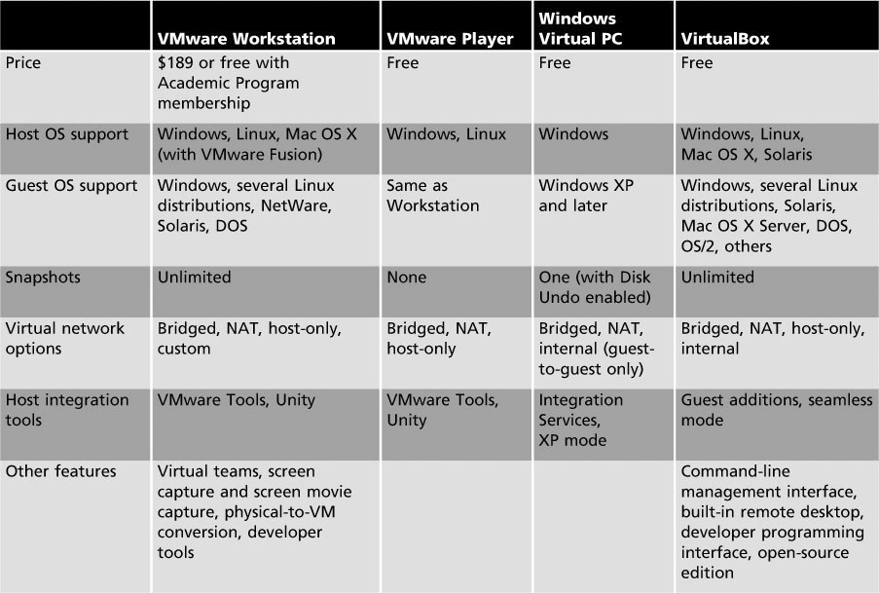
Hosted Virtualization Products
Copyright © 2012 Cengage Learning. All rights reserved.

Slide 44
Bare-Metal Virtualization
Uses a Type 1 hypervisor
Targeted mainly for production virtualization in data centers
Installed directly on hardware and has more stringent host machine requirements
Offers more features for managing VMs than hosted virtualization
  A little more complicated to install and use as well
Copyright © 2012 Cengage Learning. All rights reserved.

Slide 45
Bare-Metal Virtualization Applications
Consolidate servers
Retire old or unreliable hardware: Converting physical machines to VMs
Maintain application separation
Test installation and upgrades
Test a preconfigured application
Test what-if scenarios
Live migration
Dynamic provisioning
Copyright © 2012 Cengage Learning. All rights reserved.

Slide 46
Bare-Metal Virtualization Products
Microsoft Hyper-V – introduced with Windows Server 2008 and can be installed as a server role
Citrix XenServer – Uses Linux as a management OS on the host
VMware vSphere – includes VMware ESX Server, which is installed directly on the physical server without a management OS
Copyright © 2012 Cengage Learning. All rights reserved.

Slide 47
Installing an OS
The real work of installing an OS, particularly a network server, involves pre-installation and post-installation tasks
The roles a server will play on the network should be considered when planning a Windows Server 2008 installation
A server used to support only a dozen users has different minimum hardware requirements than a server running Active Directory and supporting a few hundred users
Copyright © 2012 Cengage Learning. All rights reserved.

Slide 48
Selecting Server Hardware for Windows Server 2008
Features you might need to decide on before purchasing a server:
  CPU architecture: Minimum requirement is a 1.4 GHz CPU
  Disk subsystem: SCSI/SAS vs. SATA
  Memory: Minimum requirement is 512 MB RAM
Copyright © 2012 Cengage Learning. All rights reserved.

Slide 49
Selecting the Right Windows Edition
Standard Edition – suitable for most small to medium businesses
Enterprise Edition – has all the features of the Standard Edition plus some extra features that make this edition suitable for medium to large businesses
Datacenter Edition – suitable for businesses managing huge amounts of data, using virtualization on a large scale, running high-end applications
Windows Web Server 2008 – designed to operate as a single-purpose Web server running Internet Information Services (IIS) 7.0
Copyright © 2012 Cengage Learning. All rights reserved.

Slide 50
Windows Server 2008 Pre-installation Decisions
What should you name the server?
Which network protocols and addresses should you use?
How should you assign an IP address to the server?
Setting the correct time zone
Should you use the workgroup or domain model?
What services should you install?
Copyright © 2012 Cengage Learning. All rights reserved.

Slide 51
Windows Server 2008 Post-installation Tasks
Activate Windows Server 2008
Set the correct date, time, and time zone
Assign a static IP address
Assign a computer name
Configure automatic updates
Download and install available updates
Add and configure roles and features
Flash Movie 2 – Installing Windows Server 2008
Copyright © 2012 Cengage Learning. All rights reserved.

Slide 52
Planning For and Installing Linux
Decide which Linux distribution to use
  A Web site called DistroWatch.com lists distributions along with descriptions
Download a disk image of the installation medium and burn it to a CD or DVD
The pre-installation and post-installation tasks for Linux are not very different from those for Windows Server 2008
  Linux requires more input and decision-making during installation
Flash Movie 3 – Installing CentOS 5.4
Copyright © 2012 Cengage Learning. All rights reserved.

Slide 53
Chapter Summary
A computer’s OS provides a number of services that enable users and devices to interact with the computer
File systems provide a method for storing, organizing, and managing access to files on a storage device
A process is a program that is loaded into memory and run by the CPU
The kernel schedules processes to run, making sure high-priority processes are taken care of first; manages memory; and makes sure I/O devices are accessed by only one process at a time
Copyright © 2012 Cengage Learning. All rights reserved.

Slide 54
Chapter Summary
An NOS provides all the features of a non-networked OS plus services that provide a method to share and access network resources
Client computers typically run a number of client software components including file and printer sharing, DNS, DHCP, and e-mail
Virtualization can be divided into two categories: hosted and bare-metal virtualization
The real work of installing an OS involves pre-installation and post-installation tasks
Some of the features to look for in a server computer include CPU architecture, disk subsystem, and amount of memory
Copyright © 2012 Cengage Learning. All rights reserved.

